Slide 1
Guide of TREND builder

Slide 2
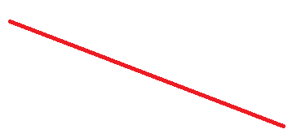
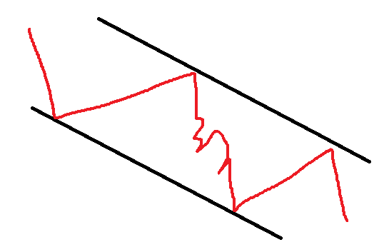
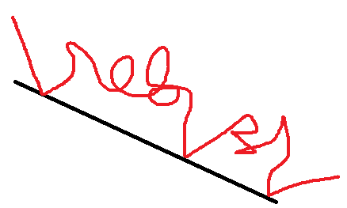
3 types of trend
Trend
Trend line
Trend channel

Slide 3
TREND
Trend is first type of trends. Point is that price continues in one direction, but doesn't need to have any SYMETRICAL specifications
To detect any trend we need to identify 3 characteristics
1.: how many candles are included in the trend
2.: how much has price moved from start to the end of trend
3.: how much was price swinging during trend

Slide 4
1. how many candles are in the trend
Trend can include from 1 to infinity candles (last candle in the realtime or searching time period in the past)
To have all options available i suggest simple form:
More than (equal or greater) [insert] value
Less than (equal or lower) [insert] value
Between (more&less) [insert] value

Slide 5
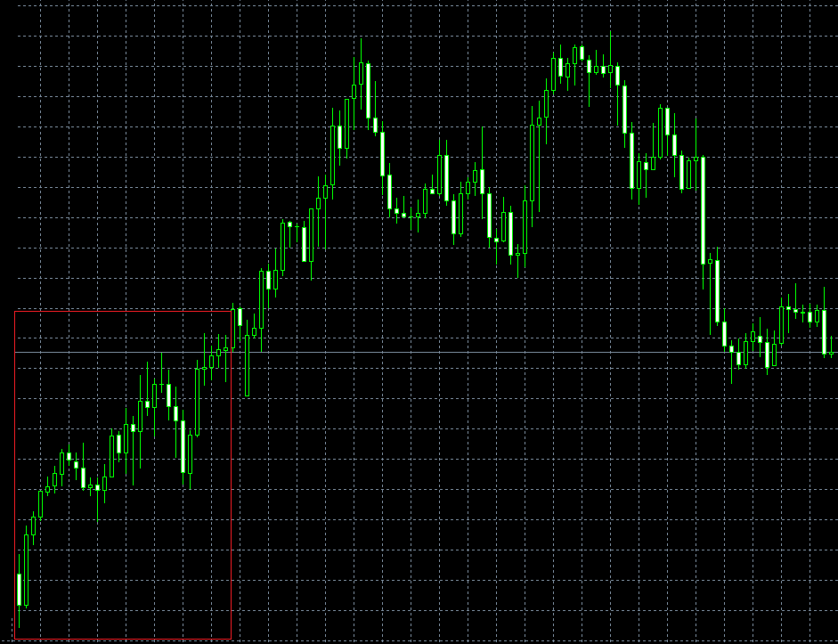
„More than“ option
Example: more than „30“ candles are in the trend
Depends of the other two characteristics
But at least 30 candles must be included (look at red field where are exactly 30 candles

Slide 6
2. price shift from start to the end
After we set length of the trend its time for price shift
1. how much percentage did price move
2. how many pips did price move
  Basically the same thing as percentage, just that some people are more used to pips (points)
3. how many times of average true range has price moved
  Useful when scanning multi time frame and pair, because of average we can get similar shift across any market
Every of this three options can be set with more, less or between (like for first characteristic of the trend

Slide 7
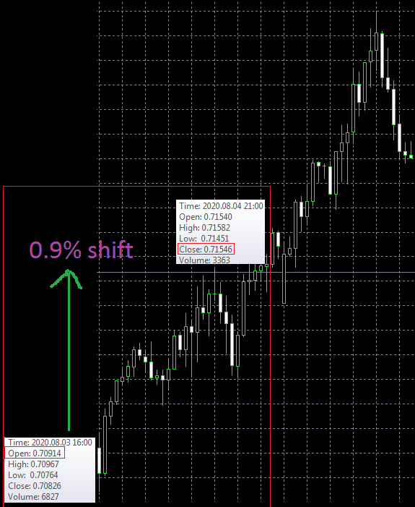
Percentage option
Example: more than „0.8%“ shift in the trend (uptrend)
If we keep settings from before
to include at least 30 candles then
Trend inside this red field would be
First possible trend to detect
(if we would choose more than 1% shift
Then this trend inside field would not
Be detected)

Slide 8
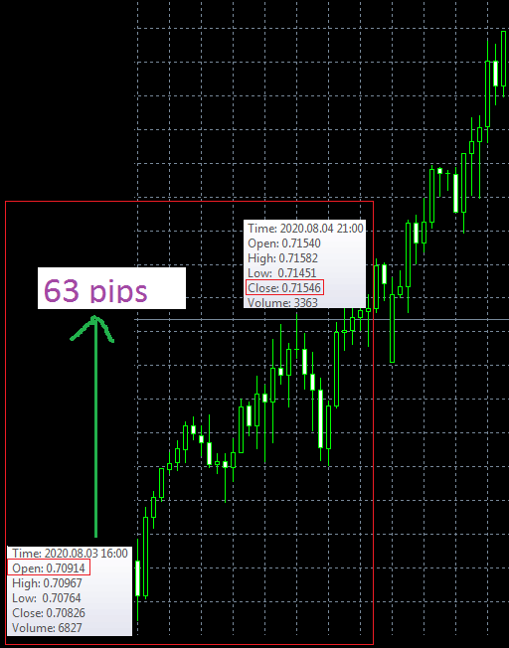
Pips (points) option
Example: more than „60 pips (600points)“ shift in the trend (uptrend)
If we keep settings from before
to include at least 30 candles then
Trend inside this red field would be
First possible trend to detect
(if we would choose more than 70 pips shift
Then this trend inside field would not
Be detected)

Slide 9
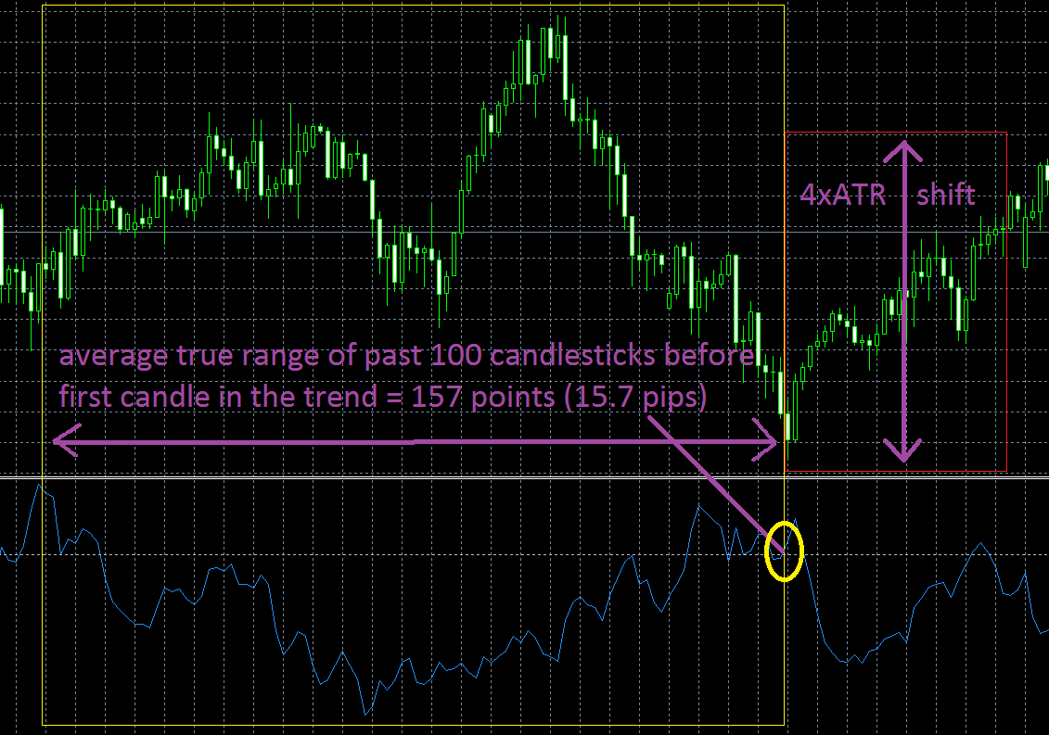
ATR (average true range) option
Example: more than „4xATR (400%)“of past „100 candlesticks before trend“ shift in the trend (uptrend)
If we keep settings from before
to include at least 30 candles then
Trend inside this red field would be
First possible trend to detect
(if we would choose more
than 5xATR shift,
Then this trend inside field would not
Be detected)

Slide 11
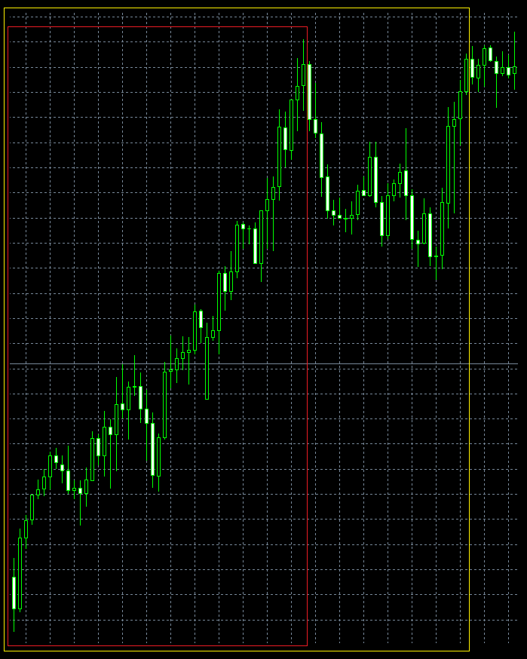
3. price deviation
Now we have option for trend
length and also trend price shift,
but to get nice and smooth trend
we need one more option for deviation
Just compare these two trends
Both red and yellow have same shift
But they are clearly not the same, yellow
One has quite a bit deviation in the
Overall shift, so its not such nice trend as red one

Slide 12
How to set price deviation
One way (overall) would be to take shift of the trend and compare it to the biggest deviation during trend. For example biggest deviation should be 0.5xshift (50%) or less. That means that at any point during trend, prince must not go back in the opposite direction (in uptrend it must not get lower for more than 50% of the whole shift value)
Second way (sections) would be to split trend into equal length sections (if trend is 60 candles long, and we split into 2 sections, then each is 30 candles long). Then we decide how much should any of the section move its price up or down (if we have 2 sections of 30 candles long, we can decide that each section must move price for at least 40% of whole trend price shift, so both sections would show strong growing trend)

Slide 13
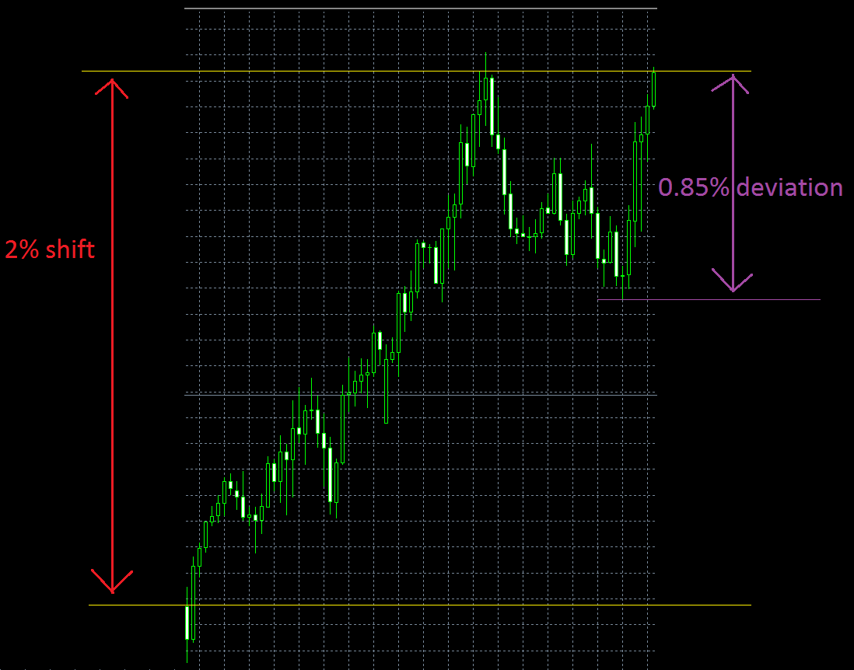
How to set price deviation (overall)
Example, lets say that
First two characteristics
Fits both of high peeks.
And if we would set deviation
To be maximum 1% of shift,
Both peeks fits the trend.
But if we set deviation to be
Maximum 0.8% of shift,
Then only first peek fits
The trend

Slide 14
How to set price deviation (overall)
Note that in this example
I measured deviation from
Lowest point (wick), but
There should be also option
To measure from lowest
Point of body (close/open).
Wicks can sometimes pierce
Through trend so for some
People it doesnt matter for same
It matters.

Slide 15
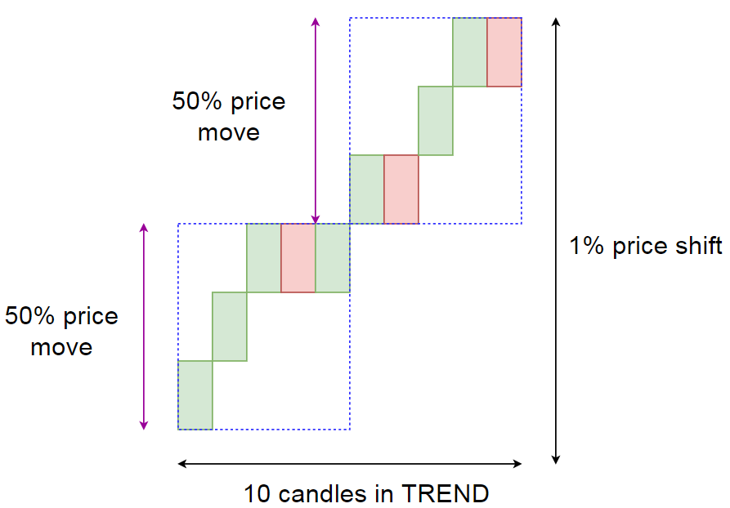
How to set price deviation (sections)
Example: first we divided whole
Trend length into 2 sections, each
Is 5 candlesticks long (because
Whole trend is 10 candles long).
And each section moves for 50%
Of whole trend price shift.
So if we set that minimum price move
Of each section should be 40%, then
Both section fits this condition and trend is valid.

Slide 16
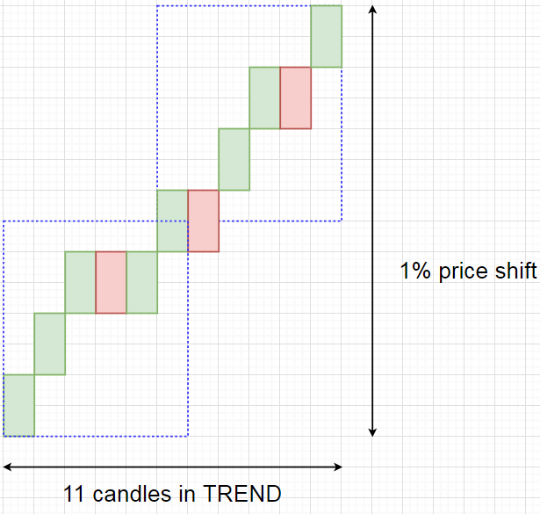
How to set price deviation (sections) ?????
If we would split 11 candles to
2 sections, then we would get
Each section 5.5 candles worth
So in this case that would be
Two sections of 6 candles (1 candle)
Would be common for both
Sections

Slide 17
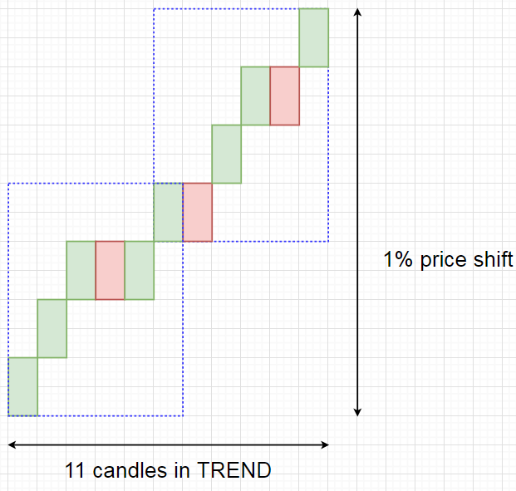
How to set price deviation (sections) ?????
And then we would get each section
Worth 50% of the whole trend shift.
same logic could apply to any number
of section with common candles in the
middle

Slide 18
TREND line
Trend line is second type of trends. Point is that price continues in one direction, and has one SYMETRICAL side that is called line.
To detect any trend we need to identify 3 characteristics
1.: how many candles are included in the trend
2.: at what angle does trend line moves
3.: touches of trend line

Slide 19
1. how many candles are in the trend
Trend can include from 1 to infinity candles (last candle in the realtime or searching time period in the past)
To have all options available i suggest simple form:
More than (equal or greater) [insert] value
Less than (equal or lower) [insert] value
Between (more&less) [insert] value

Slide 20
„More than“ option
Example: more than „30“ candles are in the trend
Depends of the other two characteristics
But at least 30 candles must be included (look at red field where are exactly 30 candles

Slide 21
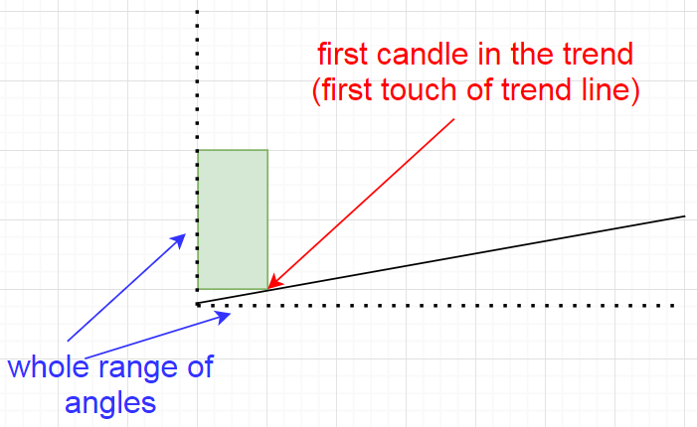
2. Angle of trend line
After we set length of the trend its time for trend line angle
Qustion is, what is the angle of trend line after first touch
  From 0 to 90°
Every angle can
be set with more, less or between
(more than 30°, less than 60°,
Between 10°and 20°…)

Slide 22
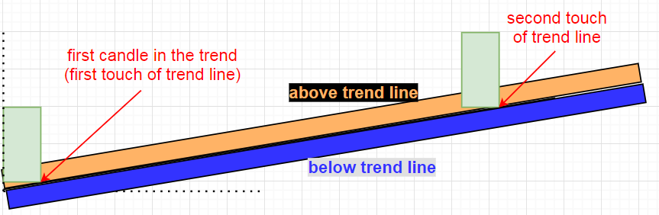
3. Trend line touch (touch zone)
When first touch (candle) happens its very rare that second touch will be exactly to 1 point precise with trend line, so we need to have some sort of range (touch zone) for touches
1. decide place of the zone
  Above(inside)/below(outside) trend line, or even both at once.

Slide 23
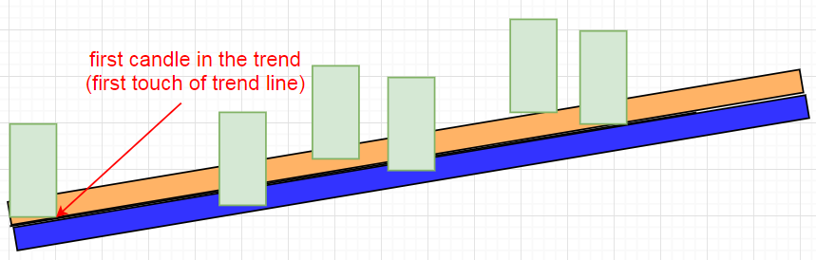
3. Trend line touch (touch zone)
  If first touch makes the trend line, all other touches can be in touch zone we
  Set.
  Touch zone can be determined with pips (above/below or both side of trend)
  Or average true value (ATR) of past candlesticks before trend line. (same as for first trend type, trend shift)

Slide 24
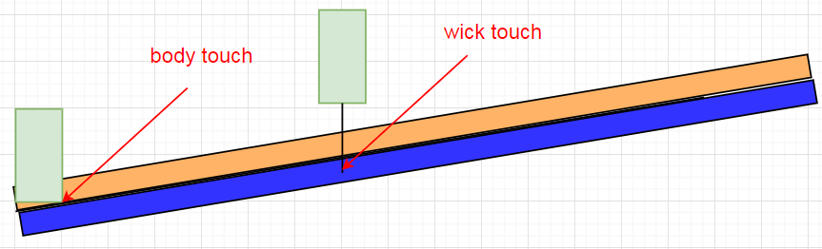
3. Trend line touch (touch type)
  We can set touch type, which can be
  Body
  Wick
  Both

Slide 25
3. Trend line touch (number of touches)
  When we got first touch and start of a trend line, we need to know, how many touches we want. So we can set this in 2 ways:
  Auto mode (there can be as many touches as we want with same properties)
  Manual mode (number of touches is restricted, but each touch can be customized) UP FOR CONSIDERATION!!!!!!!!!!!!!!

Slide 26
3. Trend line touch (auto mode touches)
  Secondly, we can set number of touches (candles that reach in touch zone)
  Simply input number (for example: 6) with greater, less or between option

Slide 27
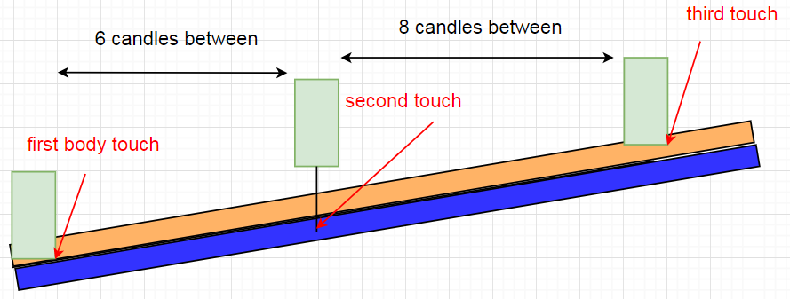
3. Trend line touch (auto mode touches)
  We can also add space option. That means how many candles must be between each touch. (if we choose to be at least 5 candles between each touch, then this image fits that condition)

Slide 28
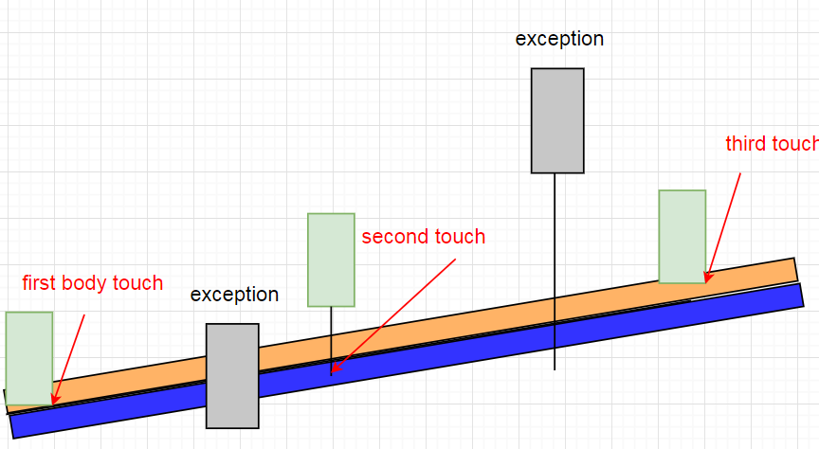
3. Trend line touch (auto mode touches)
  And there can also be exceptions. That means that there can be candles that break the previous rules (if body is set to touch, this exception can touch with wick, or even exceed the zone with wick or body. Also space between touches doesnt apply for exceptions).
  Simply insert what is
  maximum number of
  exceptions allowed,
  besides proper touches

Slide 29
TREND channel
Trend channel is third type of trends. Point is that price continues in one direction, and have trend line on both sides with SYMETRICAL characteristics
To detect any trend we need to identify 3 characteristics
1.: how many candles are included in the trend
2.: at what angle does both of trend lines moves and price shift
3.: touches of each trend line

Slide 30
1. how many candles are in the trend
Trend can include from 1 to infinity candles (last candle in the realtime or searching time period in the past)
To have all options available i suggest simple form:
More than (equal or greater) [insert] value
Less than (equal or lower) [insert] value
Between (more&less) [insert] value

Slide 31
„More than“ option
Example: more than „30“ candles are in the trend
Depends of the other two characteristics
But at least 30 candles must be included (look at red field where are exactly 30 candles

Slide 32
2. Angle of first trend line
After we set length of the trend its time for trend line angle
Qustion is, what is the angle of trend line after first touch
  From -90° to 90°
Every angle can
be set with more, less or between
(more than 30°, less than 60°,
Between 10°and 20°…)
Here we dont choose direction of first trend line, it can go down or up by default

Slide 33
3. Trend line touch (touch zone)
When first touch (candle) happens its very rare that second touch will be exactly to 1 point precise with trend line, so we need to have some sort of range (touch zone) for touches
1. decide place of the zone
  Above (inside)/below(outisde) trend line, or even both at once. This rule applies for both trend lines, first trend line, and second on the other side

Slide 34
3. Trend line touch (touch type)
  We can set touch type, which can be
  Body
  Wick
  Both

Slide 35
3. Trend line touch (number of touches)
  When we got first touch and start of a trend line, we need to know, how many touches we want. So we can set this in 2 ways:
  Auto mode (there can be as many touches as we want with same properties)
  Manual mode (number of touches is restricted, but each touch can be customized) UP FOR CONSIDERATION!!!!!!!!!!!!!!

Slide 36
3. Trend line touch (auto mode touches)
  Secondly, we can set number of touches (candles that reach in touch zone)
  Simply input number (for example: 6) with greater, less or between option

Slide 37
3. Trend line touch (auto mode touches)
  We can also add space option. That means how many candles must be between each touch. (if we choose to be at least 5 candles between each touch, then this image fits that condition)

Slide 38
3. Trend line touch (auto mode touches)
  And there can also be exceptions. That means that there can be candles that break the previous rules (if body is set to touch, this exception can touch with wick, or even exceed the zone with wick or body. Also space between touches doesnt apply for exceptions).
  Simply insert what is
  maximum number of
  exceptions allowed,
  besides proper touches

Slide 39
2. Angle of second trend line
After first trend line is formed (after first touch), we can set second trend line angle. First trend line can be formed above or below second trend line
We can also set angle from -90° to 90° but
Every angle can
be set with more, less or between
(more than 30°, less than 60°,
Between 10°and 20°…)
Here we dont choose direction of first trend line, it can go down or up by default

Slide 40
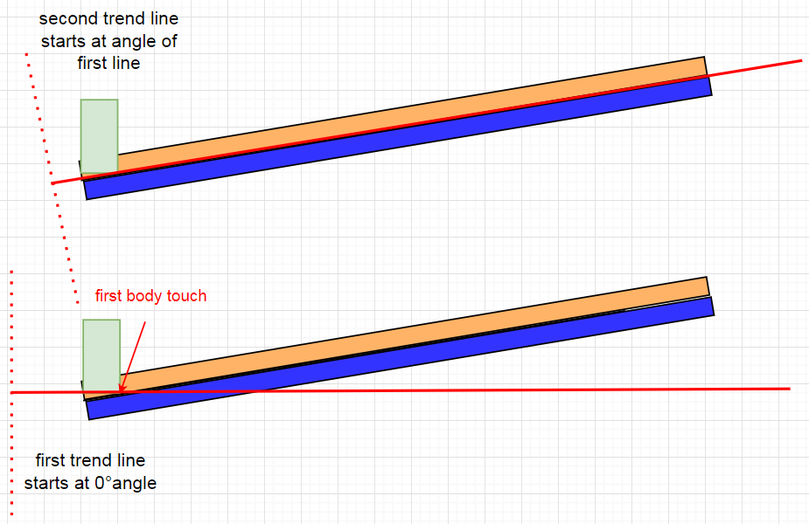
2. Angle of second trend line
First trend line starts
From 0°angle, while
Second trend line starts
From angle of first line.

Slide 41
2. price shift from start to the end
After we got first trend line, we need to set how far away is second trend line, we can use same system as for first type of trend:
1. how much percentage did price move
2. how many pips did price move
  Basically the same thing as percentage, just that some people are more used to pips (points)
3. how many times of average true range has price moved
  Useful when scanning multi time frame and pair, because of average we can get similar shift across any market
Every of this three options can be set with more, less or between (like for first characteristic of the trend

Slide 42
3. Second Trend line touch (touch zone)
When first touch (candle) happens its very rare that second touch will be exactly to 1 point precise with trend line, so we need to have some sort of range (touch zone) for touches
1. decide place of the zone
  Above(inside)/below(outisde) trend line, or even both at once. This rule applies for both trend lines, first trend line, and second on the other side

Slide 43
3. Second Trend line touch (touch type)
  We can set touch type, which can be
  Body
  Wick
  Both

Slide 44
3. Second Trend line touch (number of touches)
  When we got first touch and start of a trend line, we need to know, how many touches we want. So we can set this in 2 ways:
  Auto mode (there can be as many touches as we want with same properties)
  Manual mode (number of touches is restricted, but each touch can be customized) UP FOR CONSIDERATION!!!!!!!!!!!!!!

Slide 45
3. Second Trend line touch (auto mode touches)
  Secondly, we can set number of touches (candles that reach in touch zone)
  Simply input number (for example: 6) with greater, less or between option

Slide 46
3. Second Trend line touch (auto mode touches)
  We can also add space option. That means how many candles must be between each touch. (if we choose to be at least 5 candles between each touch, then this image fits that condition)

Slide 47
3. Second Trend line touch (auto mode touches)
  And there can also be exceptions. That means that there can be candles that break the previous rules (if body is set to touch, this exception can touch with wick, or even exceed the zone with wick or body. Also space between touches doesnt apply for exceptions).
  Simply insert what is
  maximum number of
  exceptions allowed,
  besides proper touches

