Slide 1
Guide of SnR builder
Support and Resistance

Slide 2
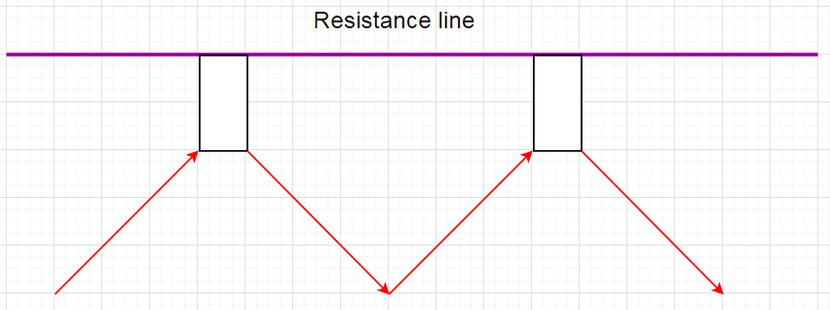
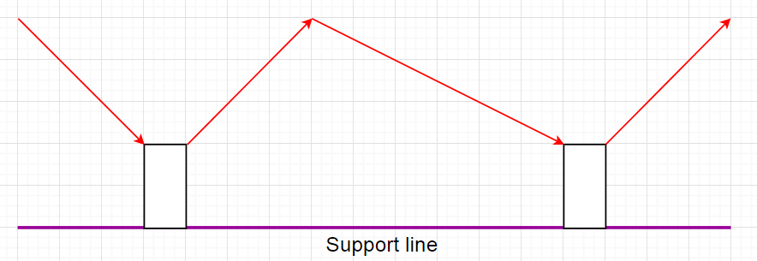
Basic idea

Slide 3
Support&Resistance parameters
SnR can have many forms so i will try to include all important characeterostics that will enable you to build various snr.
To detect any snr we need to identify next characteristics
1.: for how long does snr holds its unbreakable position before first touch
2.: first touch type
3.: how many and what touches do we want

Slide 4
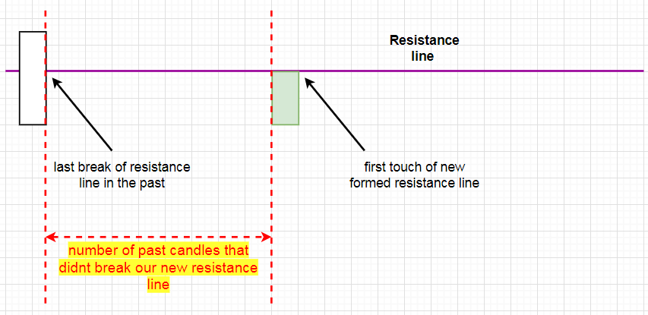
1. Unbrokenness of snr
First we want to know, for how long does our new snr holds its line without being broken in the past

Slide 5
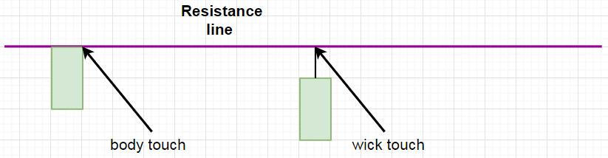
2. SNR line touch (touch type)
  We can set touch type, which can be
  Body
  Wick
  Both

Slide 6
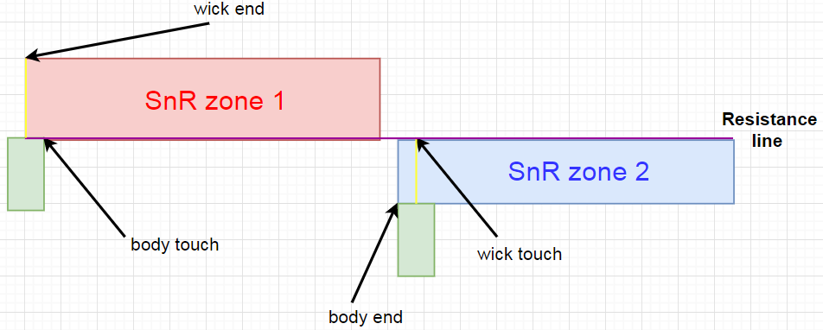
3. SNR line first touch (touch zone)
When first touch (candle) happens its very rare that second touch will be exactly to 1 point precise with trend line, so we need to have some sort of range (touch zone) for touches
Decide place of the zone
  1. enable/disable wick to body zone
  We can see two examples,
  If first touch is body
  (snr zone 1)
  If first touch is wick
  (snr zone 2)

Slide 7
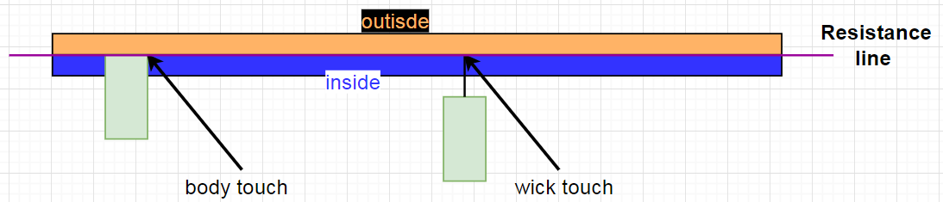
3. SNR line first touch (touch zone)
When first touch (candle) happens its very rare that second touch will be exactly to 1 point precise with trend line, so we need to have some sort of range (touch zone) for touches
Decide place of the zone
  2. inside/outside (first touch) trend line, or even both at once.

Slide 8
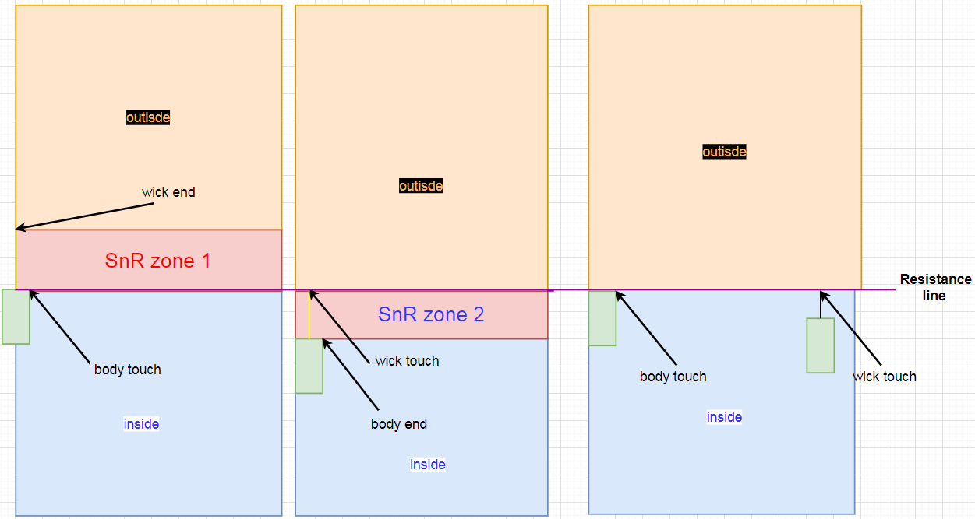
3 examples of applying inside/outside touch snr zone

Slide 9
3. SNR line first touch (touch zone)
You can use ATR, pips or body to wick
Look for previous slide for examples. If you enable body to wick,
Then inside/outside value will be added to already formed zone

Slide 10
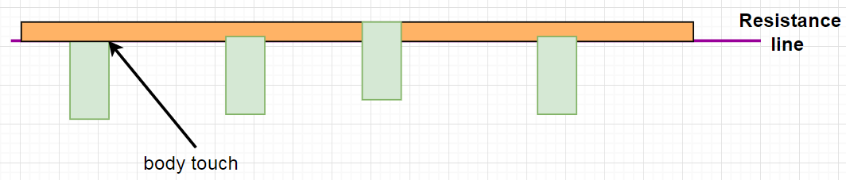
3. Trend line touch (number of touches)
  When we got first touch and start of a snr line, we need to know, how many touches we want. So we can set this in 2 ways:
  Auto mode (there can be as many touches as we want with same properties)
  Manual mode (number of touches is restricted, but each touch can be customized)

Slide 11
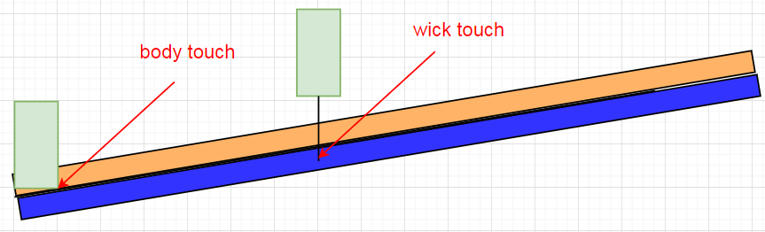
3. Trend line touch (auto mode touches)
  Secondly, we can set number of touches (candles that reach in touch zone)
  Simply input number (for example: 6) with greater, less or between option

Slide 12
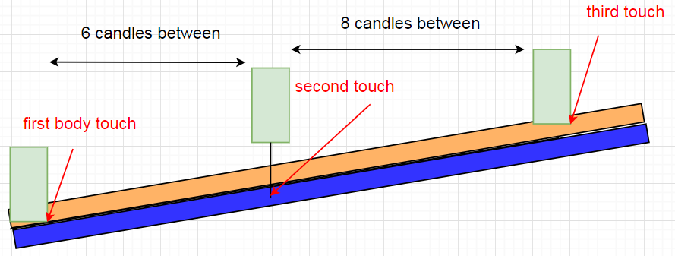
3. Trend line touch (auto mode touches)
  We can also add space option. That means how many candles must be between each touch. (if we choose to be at least 5 candles between each touch, then this image fits that condition)

Slide 13
3. Trend line touch (auto mode touches)
  We can also add space option. That means how many candles must be between each touch. (if we choose to be at least 5 candles between each touch, then this image fits that condition)

Slide 14
3. Trend line touch (auto mode touches)
Besides space between touches (measured in candles, or time), we can also set space between current price of touch and furthest price position of past candlesticks between touches
1. how much percentage did price move
2. how many pips did price move
  Basically the same thing as percentage, just that some people are more used to pips (points)
3. how many times of average true range has price moved
  Useful when scanning multi time frame and pair, because of average we can get similar shift across any market
Every of this three options can be set with more, less or between (like for first characteristic of the trend

Slide 15
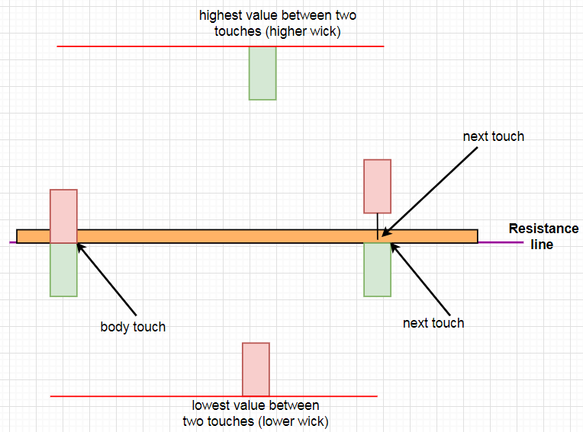
Example of price shift between two touches

Slide 16
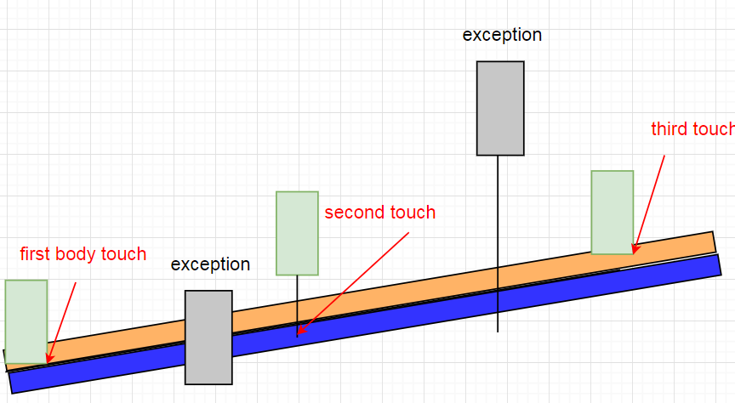
3. Trend line touch (auto mode touches)
  And there can also be exceptions. That means that there can be candles that break the previous rules (if body is set to touch, this exception can touch with wick, or even exceed the zone with wick or body. Also space between touches doesnt apply for exceptions).
  Simply insert what is
  maximum number of
  exceptions allowed,
  besides proper touches

Slide 17
3. Trend line touch (manual mode touches)
  Same as for auto mode, we can adjust:
  Space between two touches
  Price shift between two touches
  Exceptions
  And that can be done separately for second, third, fourth and fifth touch

